Slide 1

Benefits & advantages of CoolGaN™ in high power and medium power switched mode power supplies (SMPS)
Dr. Sam Abdel-Rahman – Sr. Principal System Architect
Tamara Nenita Fallosch – Sr. Manager Product Marketing
Gökhan Sen - System Application Engineer
April 2025
Notes:
Slide for Moderator

Slide 2



Speakers
Dr. Sam Abdel-Rahman
Sr. Principal System Architect
Tamara Nenita Fallosch
Sr. Manager Product Marketing
Gökhan Sen
System Application Engineer
Notes:
Slide for Moderator

Slide 3
Agenda
1
SMPS application description and trends
  4
2
CoolGaN™ in current & next-generation SMPS applications
  8
3
System application boards
  14
4
System-level key takeaways
  18
5
High voltage CoolGaN™ (650 - 700 V)
  20
5.1
Technology overview & power device comparison
21
5.2
Value proposition of HV GaN in SMPS
26
5.3
Portfolio leadership
29
6
Medium voltage CoolGaN™ (60 - 200 V)
  31
6.1
Technology overview & power device comparison
32
6.2
Value proposition of MV GaN in SMPS
35
6.3
Portfolio leadership
42
Notes:
Slide for Moderator

Slide 4
Agenda
1
SMPS application description and trends
4
2
CoolGaN™ in current & next-generation SMPS applications
  8
3
System application boards
  14
4
System-level key takeaways
  18
5
High voltage CoolGaN™ (650 - 700 V)
  20
5.1
Technology overview & power device comparison
21
5.2
Value proposition of HV GaN in SMPS
26
5.3
Portfolio leadership
29
6
Medium voltage CoolGaN™ (60 - 200 V)
  31
6.1
Technology overview & power device comparison
32
6.2
Value proposition of MV GaN in SMPS
35
6.3
Portfolio leadership
42

Slide 5

AC/DC SMPS block diagram
PFC
HV DC/DC
Sync rectifiers
+ ORing
85 - 265 V_{AC}
12 V ... 48 V
Isolation
Gate driver IC
Aux. SMPS
Gate driver IC
Gate driver IC
Flyback controller
PFC controller
DC/DC controller
Isolator
This block diagram shows power stages and topologies of SMPS

Slide 6
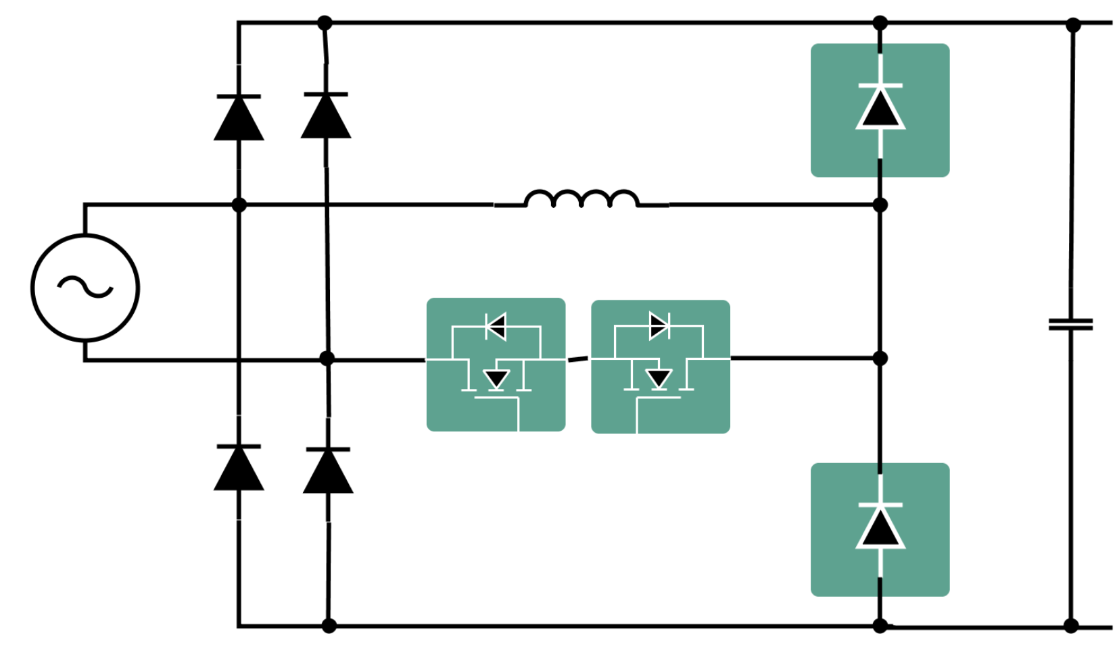
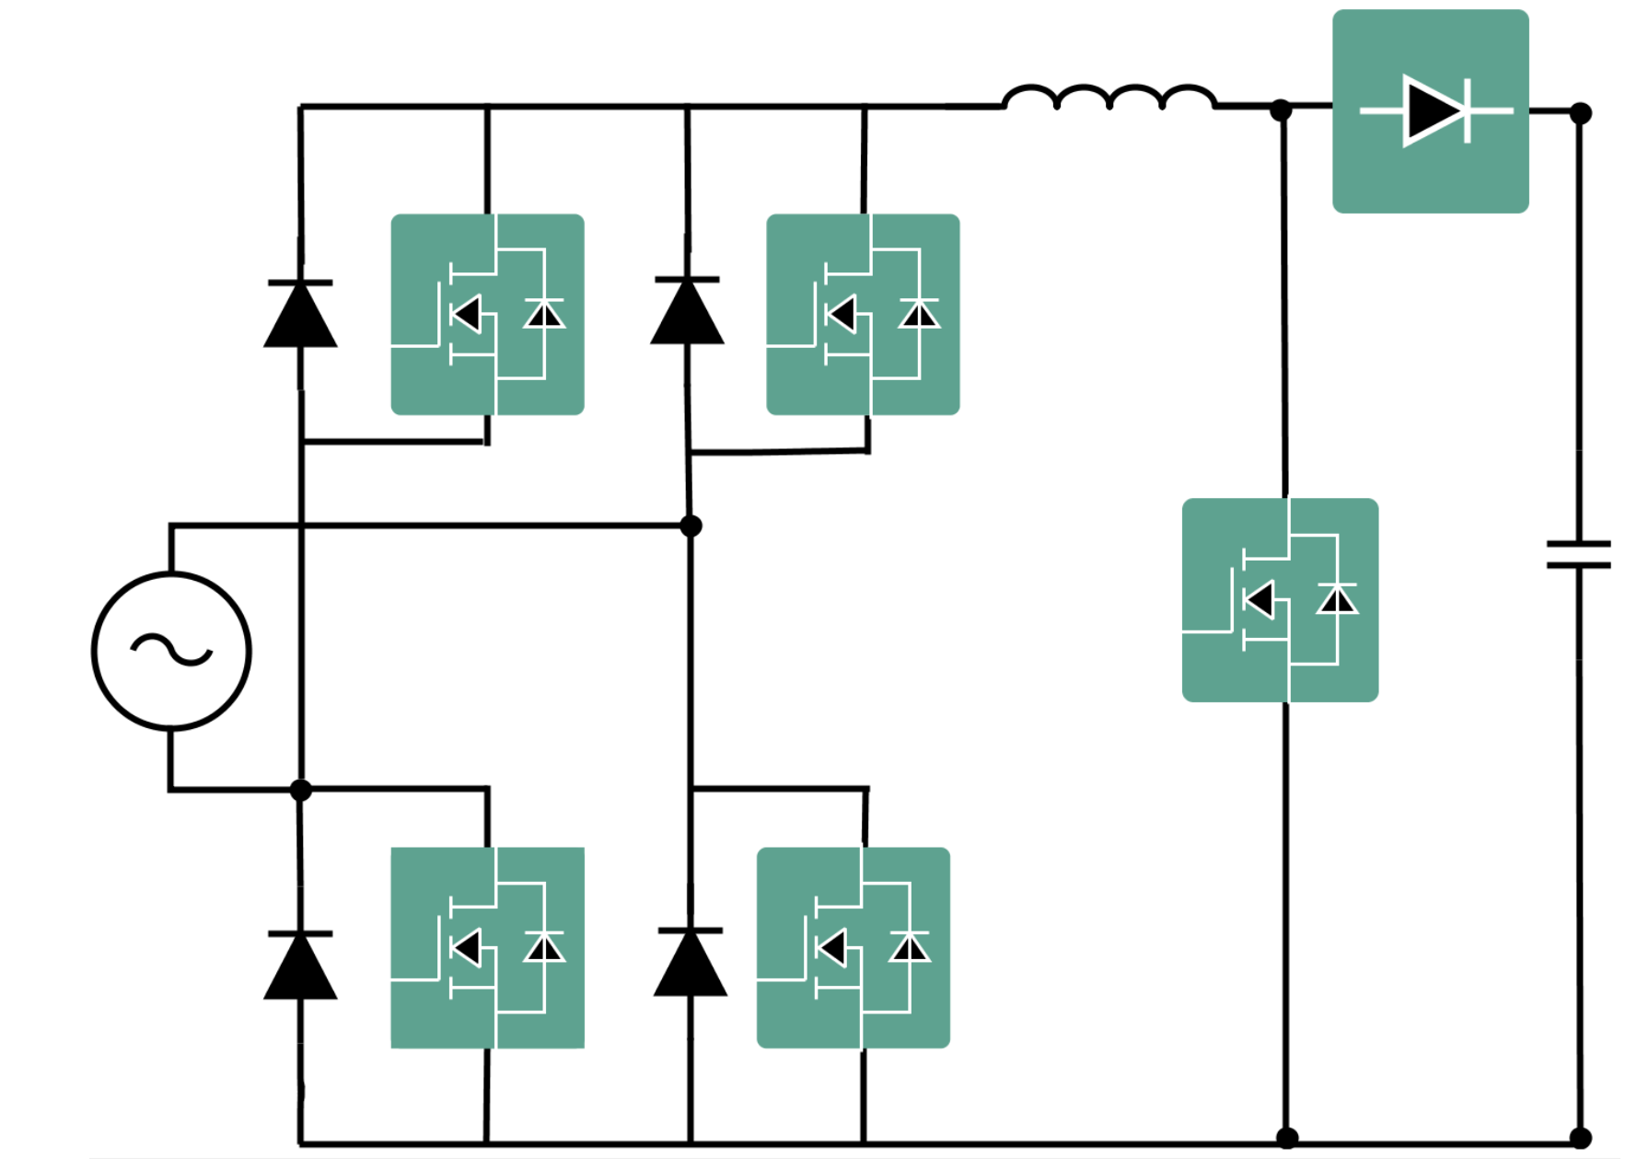
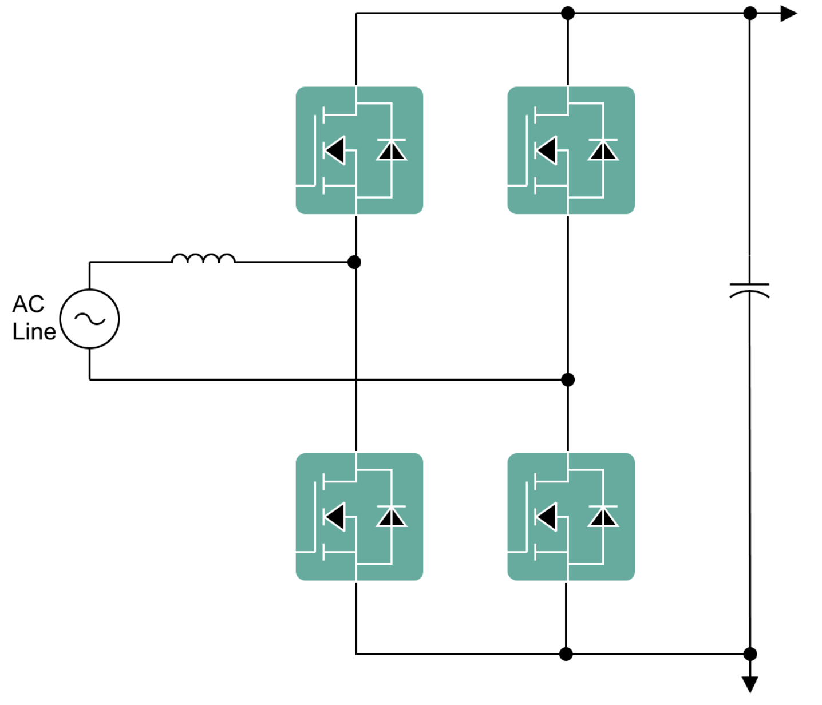
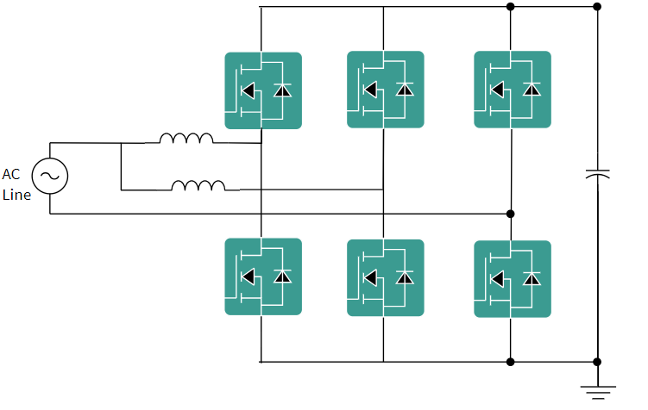
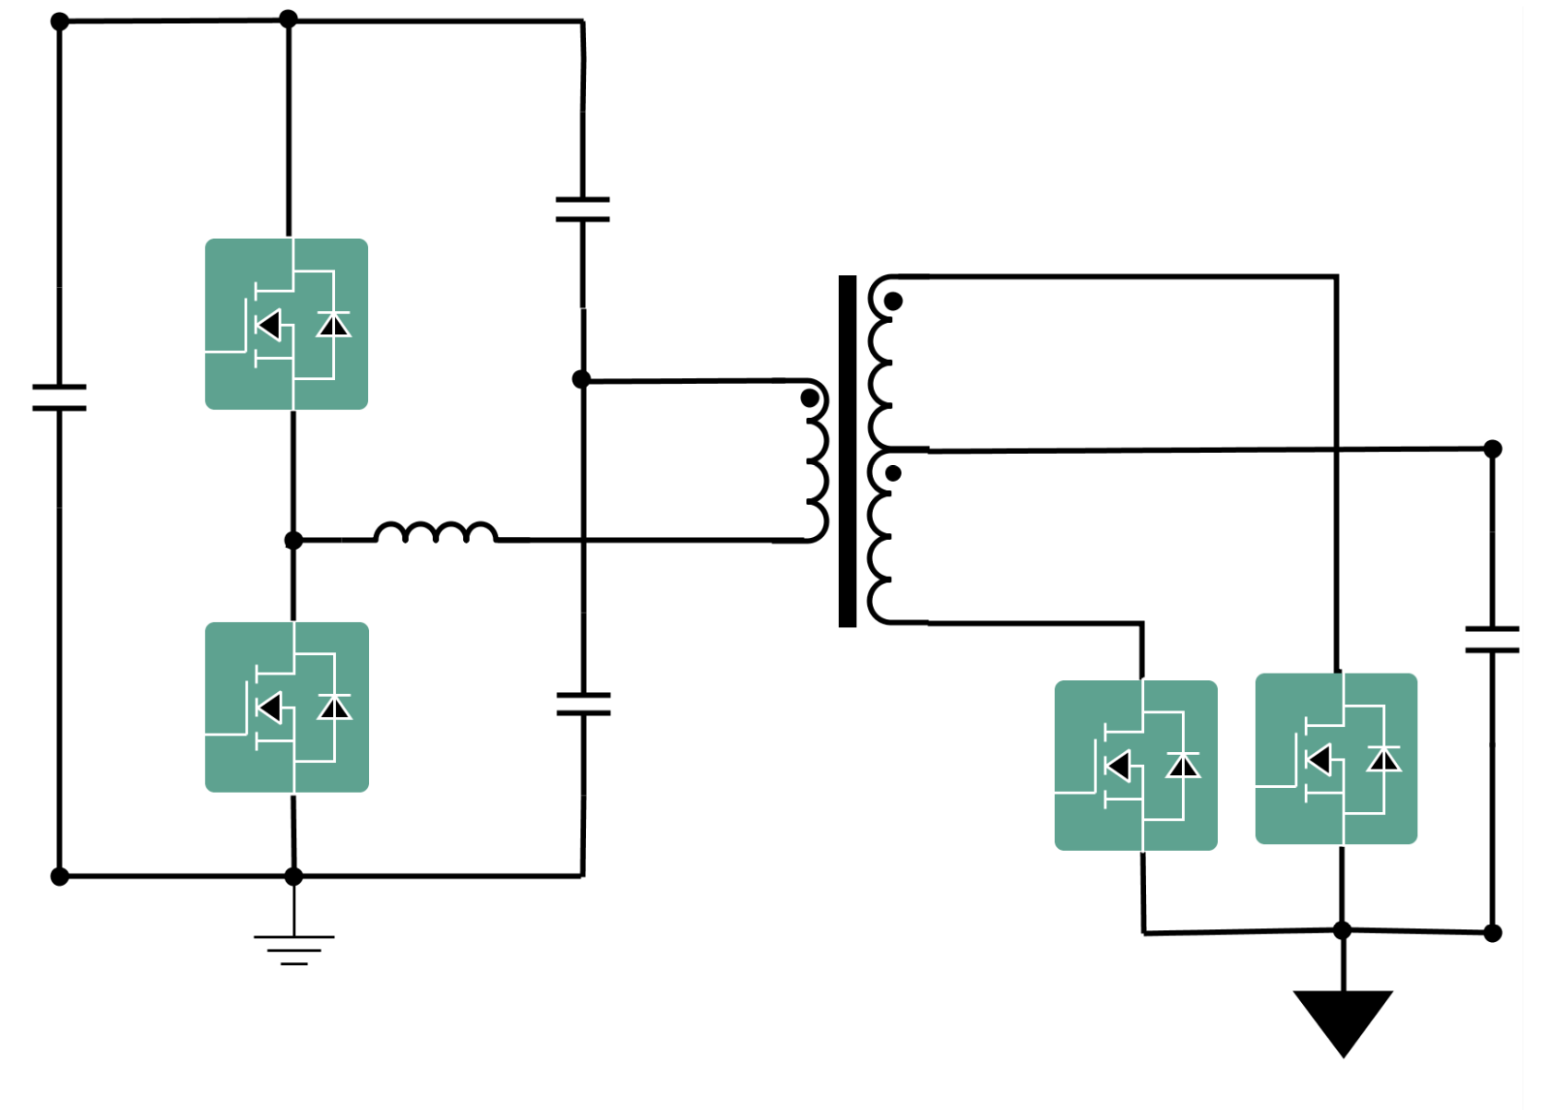
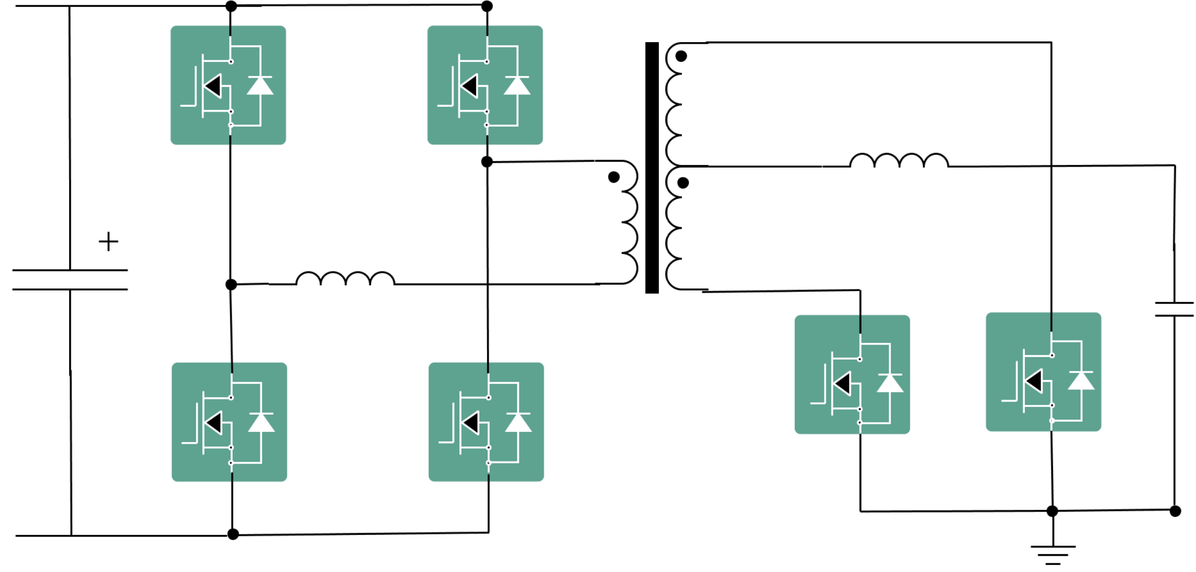
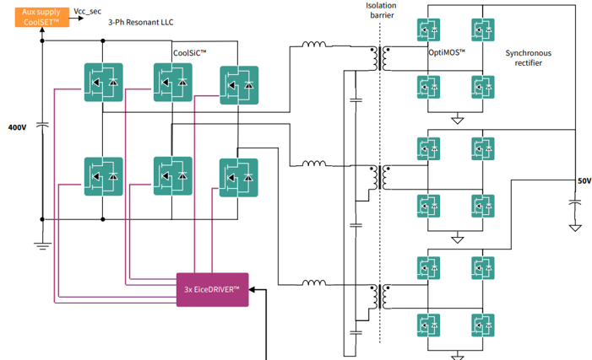
CoolGaN™ in PFC and DC/DC topologies
Legacy (past)
Mainstream (today)
In development (future)
H4 bridge
Classic boost w/ Active bridge
CCM totem pole
Interleaved TCM totem pole
Si
Si
GaN
Si
GaN
Si
PFC
ƞ= ~98%
Low system cost
2x CoolMOS™ 600 V
2x CoolSiC™ diode
ƞ= ~98.5%
Higher system cost
1x CoolMOS™ 600 V
1x CoolSiC™ diode
4x CoolMOS™ 600 V
ƞ= ~99%
Low system cost
2x CoolGaN™ Transistor 650 V G5
2x CoolMOS™ CM8 600 V
ƞ= ~99.2%
Low system cost
4x CoolGaN™ Transistor 650 V G5
2x CoolMOS™ CM8 600 V
ZVS PSFB
LLC
3-phase LLC
High frequency LLC f_{sw} > 300kHz
GaN
GaN
Si
GaN
Si
GaN
GaN
Si
GaN
GaN
DC-DC
ƞ= ~98.5%
Full resonant ➔ less EMI
Full soft switching ➔ highest efficiency
Half/Full Bridge / Interleaved ➔ scalable
CoolGaN™ Transistor 650 V G5
CoolGaN™/ OptiMOS™ 40 – 80 V
ƞ= ~97.5%
Quasi resonant
ZVS lost at light load
4x CoolGaN™ Transistor 650 V G5
OptiMOS™ / CoolGaN™ 60 – 200 V
ƞ= ~98.5%
Highest density
CoolGaN™ Transistor 650 V G5
CoolGaN™ Transistor 40 - 80 V G3
ƞ= ~98.5%
Higher power
Natural current sharing
CoolGaN™ Transistor 650 V G5
CoolGaN™/ OptiMOS™ 40 - 80 V
CoolGaN™ offers efficiency up to 99% in today and next generation topologies

Slide 7
SMPS applications trends and GaN value
Trend
Description
Power, density, efficiency
Server SMPS reaching 5.5, 8 and 12 kW, with densities > 100 W/in³
Telecom SMPS reaching 5 – 6 kW in thin form factor (height typ. 22 - 27 mm)
BBU power and density reaching up to 25 kW > 300 W/in3
Industrial chargers increase charging rate beyond 3C➔ doubling SMPS power and density
Titanium efficiency standard 96%
GaN values
Totem-pole PFC higher efficiency enabled by CoolGaN™
LLC high frequency and density enabled by CoolGaN™
In telecom, CoolGaN™ enables natural convection cooling SMPS (fan less)
In industrial chargers, CoolGaN™ reduces power losses caused by increased power rating

Slide 8
Agenda
1
SMPS application description and trends
  4
2
CoolGaN™ in current & next-generation SMPS applications
8
3
System application boards
  14
4
System-level key takeaways
  18
5
High voltage CoolGaN™ (650 - 700 V)
  20
5.1
Technology overview & power device comparison
21
5.2
Value proposition of HV GaN in SMPS
26
5.3
Portfolio leadership
29
6
Medium voltage CoolGaN™ (60 - 200 V)
  31
6.1
Technology overview & power device comparison
32
6.2
Value proposition of MV GaN in SMPS
35
6.3
Portfolio leadership
42

Slide 9
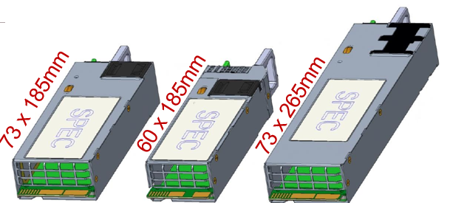

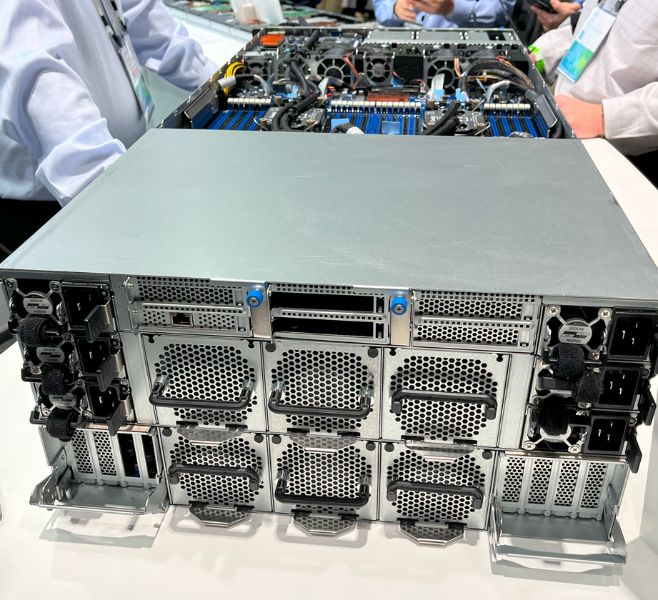
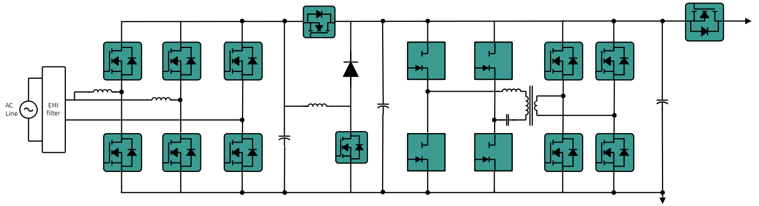
CoolGaN™ in current & next generation enterprise AI server with M-CRPS SMPS
Current generation PSU
Next generation PSU
3 - 3.2 kW / 12 V
73 x 40 x 185 mm
~100 W/inch³ & 96% efficiency
CoolGaNTM Transistors in PFC and LLC
3.6 - 4 kW / 12 V
73 x 40 x 185 mm
>120 W/inch³ & 96% efficiency
CoolGaNTM Transistors in PFC and LLC
PSU
3 kW CRPS PSU (3+3 redundancy)
Interleaved totem-pole PFC 2 x 70 kHz
Full-bridge LLC Fres = 100 - 500 kHz
CoolGaNTM Transistors 650 V G5
IGT65R035D2
IGT65R055D2
CoolGaNTM Transistors 650 V G5
IGOT65R025D2
IGLT65R017D2
CoolGaNTM Transistors 80 V G3
IGC019S08S1
IGC025S08S1
GaN
GaN
GaN
Hold-up time extension
650 V
400 V
650 V
80 V
50 V
230 V_{AC}
CoolGaN™ enables power density >120 W/in³ and efficiency >96% in next generation power supplies
Source: OCP Global Summit, October 2024

Slide 10
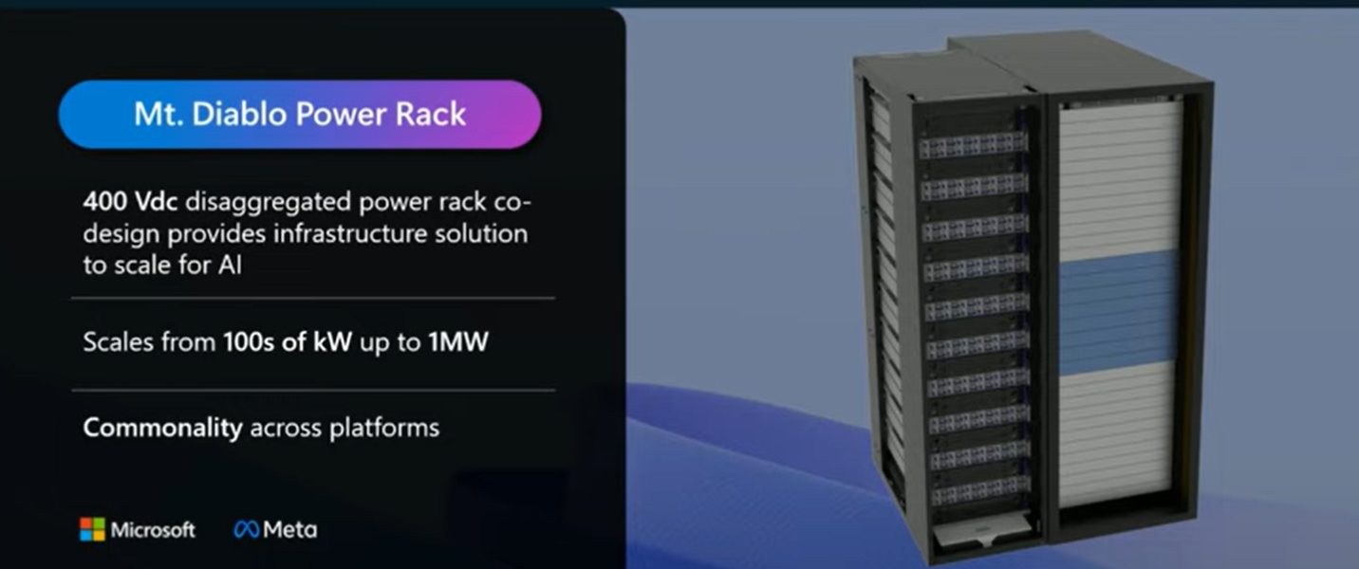
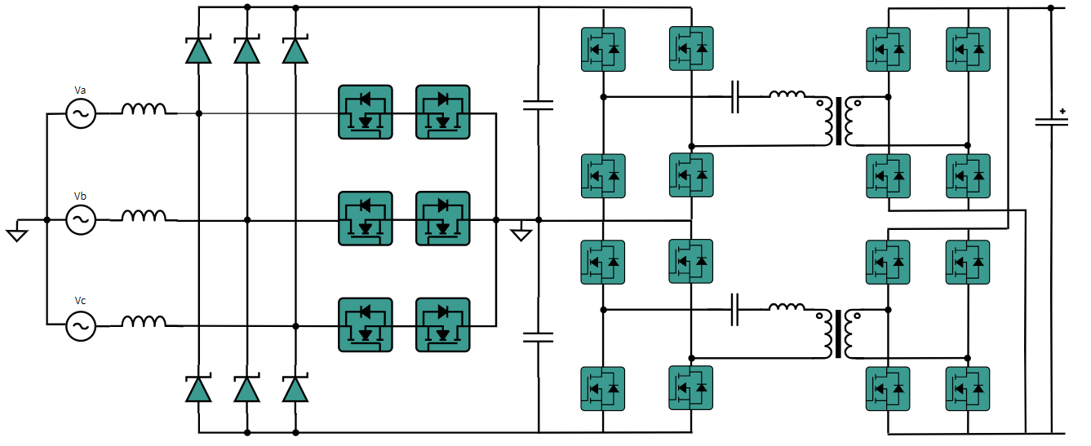


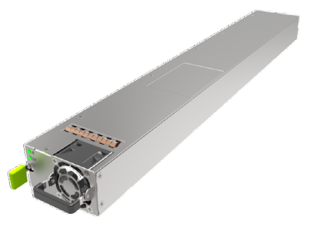
CoolGaN™ in next generation hyperscale AI server SMPS
Vienna PFC
Full-bridge LLC
CoolGaNTM BDS
650 V G5
IGOT65R025B2
CoolGaNTM Transistors
650 V G5
IGOT65R025D2
IGLT65R017D2
CoolGaNTM Transistors
650 V G5
IGOT65R035D2
IGLT65R017D2
Next generation server rack:
3-phase input
HVDC 400 V output
Up to 1 MW
GaN
BDS
GaN
GaN
650 V
650 V
650 V
400 V
480 V_{AC} L-L
2x
2x CoolSiCTM FET
430V
2x
Replaced by
1x CoolGaNTM BDS
430V
Source: OCP Global Summit 2024 - Microsoft
Bidirectional CoolGaNTM replaces 2 x 650 V SiC in 3-ph Vienna PFC
CoolGaNTM
for soft-switching / high frequency LLC
HVDC (400 V bus voltage) requires CoolGaN™ Transistors 650 V G5 SR switches

Slide 11
AI demands PSU with higher peak power and transient dynamics
GPU draws high peak power and high load transient ➔ LLC stage must deliver
Higher LLC switching frequency is needed to increase the control loop bandwidth
Load for AC/DC AI power
ORv3-HPR
190% Load
500 μs
500 μs
Peak power specs according to GPU spec
160% Load
5 ms
50ms | 400μs
136% | 160%
130% Load
50 ms
2.5 A/μs
100% Load
1000 ms
10% Load
500 μs
CoolGaNTM along with PSoC™ C3 P8 MCU enable highest switching frequency up to 1 MHz

Slide 12
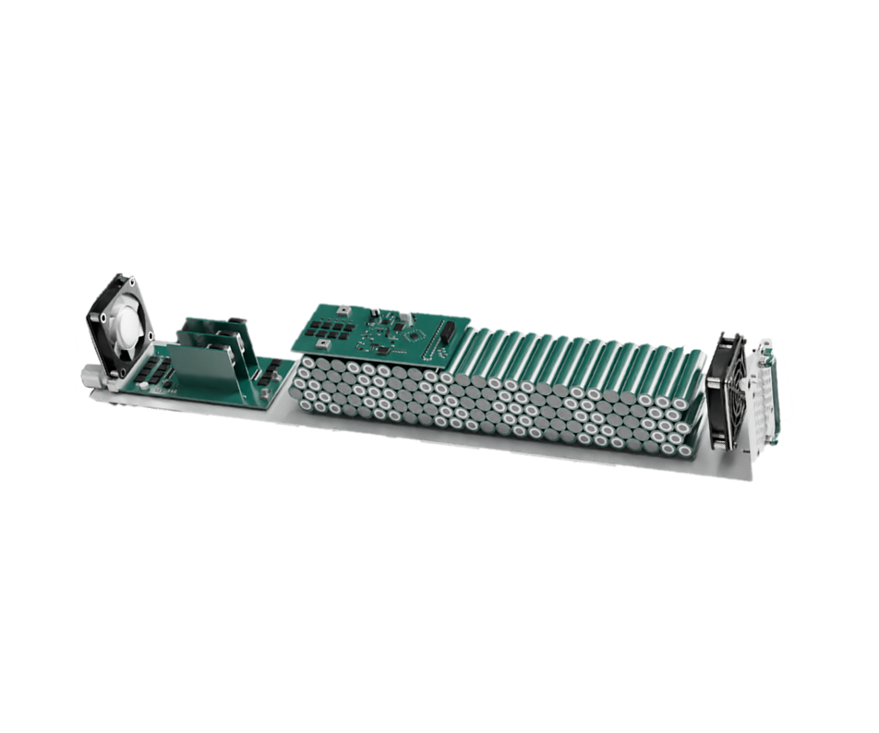
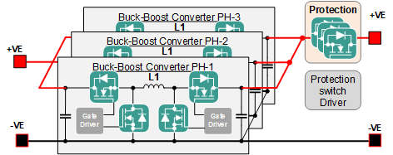
CoolGaN™ in next generation server BBU (battery back-up unit)
BBU
Battery
Battery managements system
DC/DC converter
State of art solutions for 48 V bus architecture
Topology | Multiphase buck or boost | Multiphase buck boost
Limited to | <44 V_{BAT_MAX} | <60 V_{BAT_MAX}
 | <4.4 kW | >4.4 kW to <12 kW
Increasing power density
xN
xN
State of Art Limit
  CoolGaNTM Transistors in BBUs DC/DC converters offer high power density of 1029 W/in³ at 25 kW BBU module power

Slide 13

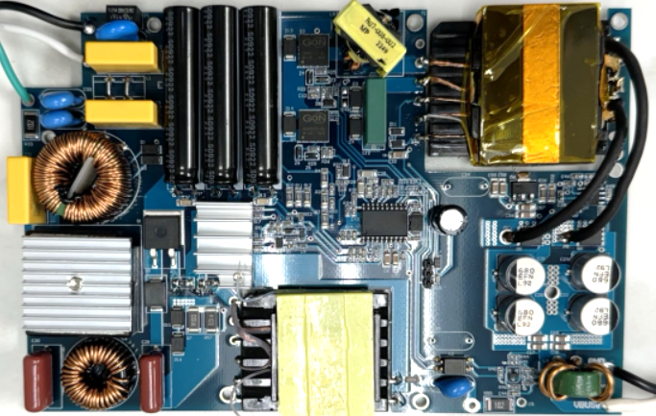
CoolGaNTM in monitor power SMPS
Si-based 200 W monitor power | Qisda 250W TV Power
SPEC | 90 – 264 V_{AC} 20 V_{out} / 10 A
Topology | PFC + LLC
PCB layer | 2 layer 2Oz
Height | <24.5 mm
Case size | 220 x 155 x 24.5 mm
Power density | 3.9 W/inch³
GaN-based 250 W monitor power | Qisda 250W TV Power
SPEC | 90 - 264 V_{AC} 19.5 V_{out} / 13 A
Topology | PFC + LLC
PCB layer | 2 Layer 2Oz
Height | <16 mm
Case size | 165 x 110 x 16 mm
Power density | 14.1 W/inch³
2%+ Efficiency improvement with CoolGaNTM
Efficiency
91.26%@ Si-Based 200W 115 V_{AC}
Output power (W)
System level optimization with CoolGaNTM increases power density nearly 4x and efficiency up to 96%

Slide 14
Agenda
1
SMPS application description and trends
  4
2
CoolGaN™ in current & next-generation SMPS applications
  8
3
System application boards
14
4
System-level key takeaways
  18
5
High voltage CoolGaN™ (650 - 700 V)
  20
5.1
Technology overview & power device comparison
21
5.2
Value proposition of HV GaN in SMPS
26
5.3
Portfolio leadership
29
6
Medium voltage CoolGaN™ (60 - 200 V)
  31
6.1
Technology overview & power device comparison
32
6.2
Value proposition of MV GaN in SMPS
35
6.3
Portfolio leadership
42

Slide 15

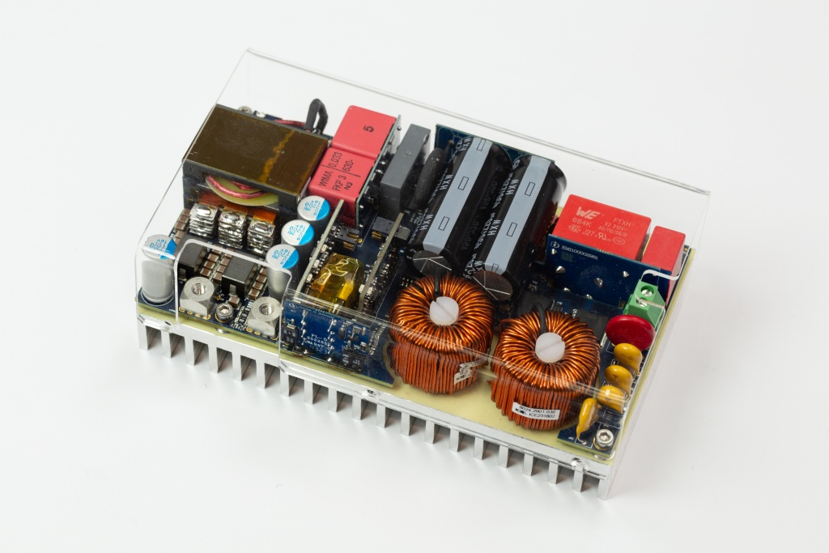
Reference board 1 kW fanless telecom SMPS
REF_1KW_PSU_5G_GaN
Technical details
Visit web page
Input voltage | Nom. 100 - 250 V_{AC}; Max 85 - 305 V_{AC}
Output voltage | 12 V
Output current | 83 A
Output power | 1000 W
Efficiency | ≥ 96% peak
Height | 1U
Cooling | Natural convection
Ambient Temperature | -40 to 70° C
Board Status | Available (Sales Product Name REF_1KW_PSU_5G_GAN)
Just as example of outdoor edge server
Learn More
Infineon components | CoolGaNTM 600 V G1 (IGT60R070D1) CoolMOSTM S7 600 V (IPT60R022S7) and CFD7 (IPT60R055CFD7) OptiMOSTM 40 V (BSC009N04LSSC), all in SMD packages top side cooling
Features
Benefits
CCM totem pole PFC
HB LLC
Full digital control in both PFC and LLC
Fan-less design
Typ. telecom surge requirements fulfillment
Addressing the new requirements of outdoor edge computing SMPS
Innovative fan-less cooling concept demonstrator
Low profile
High efficiency
Power density: 2 x 500 W PSU version (same form factor as 500 W PSU)

Slide 16
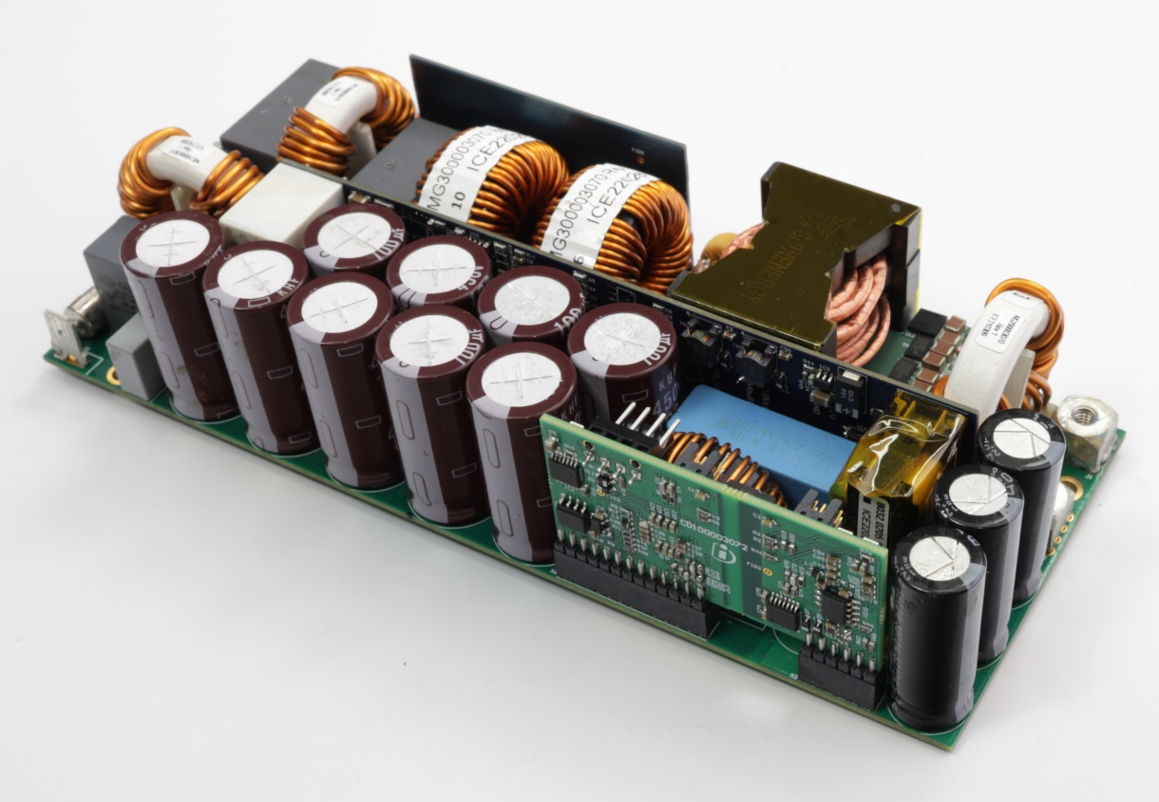



Reference board 3.3 kW server SMPS - High frequency and high density
REF_3K3W_HFHD_PSU
 | Technical details
Input voltage range | 180 V_{AC} ~ 275 V_{AC}
Output voltage range | 51 - 48 V_{DC}
Output power maximum | 3300 W
Efficiency target | ~97.5 % (without fan)
Power factor (load > 10%) | PF > 0.95 @ 180 ~ 275 V_{AC} iTHD < 10 % @ 180 ~ 275 V_{AC}
Ambient temperature | 0 °C to 50 °C
LLC Resonant frequency | 530 kHz
Board Status | Available (Sales Product Name- REF_3K3W_HFHD_PSU)
Learn More
Infineon components | CoolGaNTM Transistor 600 V G5 (IGT60R042D2) CoolSiC™ MOSFET 650 V (IMT65R057M1H) CoolMOSTM 600 V (IPT60R022S7, IPT60R016CM8^{NEW}) CoolSiC™ Schottky diode 650 V (IDL10G65C5) EiceDRIVER™ (2EDB9259Y, 1EDN8511B, 1EDN8550B, 1EDB8275F) OptiMOS™ 5 (IQE046N08LM5) CoolMOS™ 800 V (ICE2QR2280G) Schottky diode (BAT46WJ, BAT165) MOSFET 60 V (BSS138N) OPTIREGTM Switcher (TLS4120D0EPV33) Digital isolator (4DIR1400H) Controller (XMC4200-Q48K256 for PFC, 3rd Party dsPIC33CK256MP203 for LLC)
Visit web page
40 mm
192 mm
72 mm
Interleaved totem-pole PFC 2 x 65 kHz
Hold-up time extension circuit
Half bridge LLC 450 kHz-1.5 Mhz
GaN
T_{R}
Features
Benchmark 97.4% of efficiency: ~96 W/in³ in 1U form-factor
Highest efficiency & power density with CoolMOS™, CoolSiC ™, CoolGaN™
Custom integrated planar magnetic construction
Full digital control (PFC and DC/DC)
Totem-pole SiC PFC + Half-bridge GaN LLC
Benefits
Full Infineon‘s semiconductor solution
Complete power supply unit (PSU) including PFC + DC/DC
High efficiency, custom and in-house design integrated magnetics
Hold up time extension circuit

Slide 17
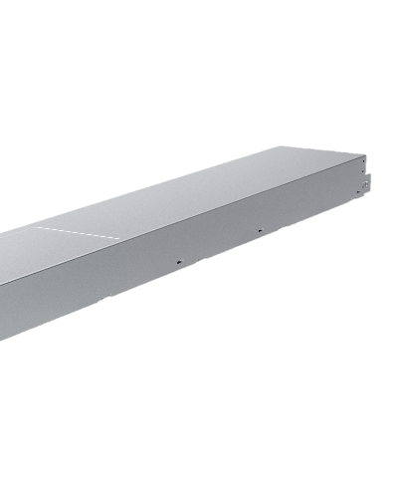

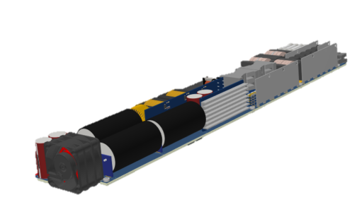
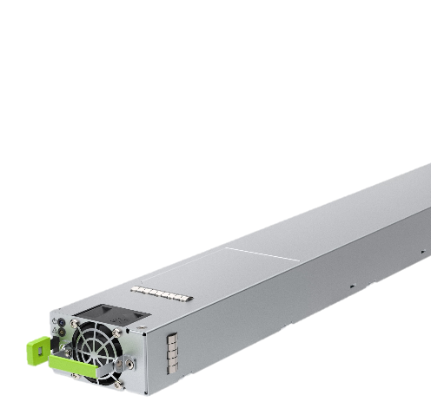
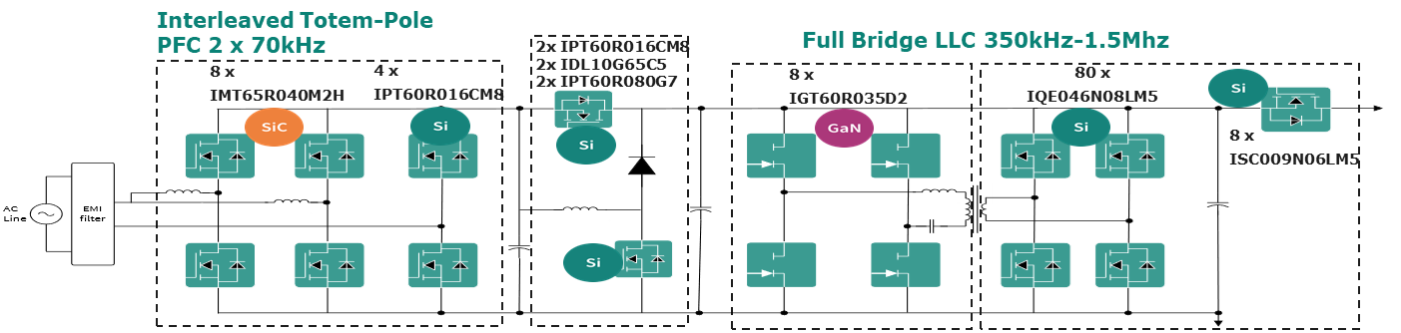
Reference board 8 kW server SMPS
REF_8KW_HFHD_PSU
Technical details
Input voltage range | 180 V_{AC} ~ 275 V_{AC}
Output voltage | 50 V_{DC} nominal
Output current | 160 A
Output power max | 8000 W
Efficiency | ~ 98%
Power factor (load > 10%) | PF > 0.98, 20%→80% load iTHD < 10%, 20%→80% load
Temperature Ambient | 0°C to 40°C
Visit web page
446mm
1-ph AI PSU 8 kW
73.5 x 720 x 40 mm
Learn more
Infineon components | CoolGaNTM Transistor 650 V G5 (IGT65R035D2) CoolSiC™ MOSFET 650 V (IMT65R040M2H, IMT65R015M2H) CoolMOSTM 600 V ( IPT60R016CM8, IPT60R050G7) CoolSiC™ Schottky diode 650 V (IDL12G65C5) OptiMOS™ 5 (IQE03xN08LM6) OptiMOS™ 80 V (ISC018N08NM6) EiceDRIVER™ (1EDB8275F, 1EDN8511B, 2EDB9259Y, 1EDN8550B) Schottky diode (BAT46WJ, BAT165) MOSFET 60 V (BSS138N) CoolMOS™ 800 V (ICE2QR2280G) OPTIREGTM Switcher (TLS4120D0EPV33) Digital isolator ( 4DIR1400H) Controller (XMC4200 for PFC, 3rd party MCU for LLC) (components could be a subject to change)
40mm
73.5mm
Features
Highest efficiency & power density with CoolMOSTM 8, CoolSiCTM , CoolGaNTM
Novel integrated planar magnetic construction
Full digital control (PFC and DC/DC)
Interleaved totem-pole PFC + Full-bridge GaN LLC
Benefits
98% peak efficiency
Power density 113 W/in³ (-38% volume vs ORv3 specification)
Hold up time extension circuit for 20 ms @100% Load
400 kHz LLC switching frequency enabled with GaN

Slide 18
Agenda
1
SMPS application description and trends
  4
2
CoolGaN™ in current & next-generation SMPS applications
  8
3
System application boards
  14
4
System-level key takeaways
18
5
High voltage CoolGaN™ (650 - 700 V)
  20
5.1
Technology overview & power device comparison
21
5.2
Value proposition of HV GaN in SMPS
26
5.3
Portfolio leadership
29
6
Medium voltage CoolGaN™ (60 - 200 V)
  31
6.1
Technology overview & power device comparison
32
6.2
Value proposition of MV GaN in SMPS
35
6.3
Portfolio leadership
42

Slide 19

System-level key takeaways
SMPS in various applications is trending towards higher power, density and efficiency
CoolGaN™ has best FOMs and lowest R_{DS(on)} to enable new topologies and higher switching frequency
Totem pole PFC higher efficiency enabled by CoolGaN™
LLC higher frequency and density enabled by CoolGaN™
CoolGaN™ enables natural convection cooling SMPS (fan less)
A broad portfolio of CoolGaN™ Transistors, drivers, BDS, and system evaluation boards are available and in development to meet application requirements and accelerate customers’ designs

Slide 20
Agenda
1
SMPS application description and trends
  4
2
CoolGaN™ in current & next-generation SMPS applications
  8
3
System application boards
  14
4
System-level key takeaways
  18
5
High voltage CoolGaN™ (650 - 700 V)
20
5.1
Technology overview & power device comparison
21
5.2
Value proposition of HV GaN in SMPS
26
5.3
Portfolio leadership
29
6
Medium voltage CoolGaN™ (60 - 200 V)
  31
6.1
Technology overview & power device comparison
32
6.2
Value proposition of MV GaN in SMPS
35
6.3
Portfolio leadership
42
Notes:
Slide for Moderator

Slide 21
Agenda
1
SMPS application description and trends
  4
2
CoolGaN™ in current & next-generation SMPS applications
  8
3
System application boards
  14
4
System-level key takeaways
  18
5
High voltage CoolGaN™ (650 - 700 V)
20
5.1
Technology overview & power device comparison
21
5.2
Value proposition of HV GaN in SMPS
26
5.3
Portfolio leadership
29
6
Medium voltage CoolGaN™ (60 - 200 V)
  31
6.1
Technology overview & power device comparison
32
6.2
Value proposition of MV GaN in SMPS
35
6.3
Portfolio leadership
42

Slide 22








CoolGaN™ Transistor 650 V G5 for highly efficient power conversion in SMPS applications
CoolGaN™ targets consumer & industrial applications
enabling high-frequency operation & increased power density

Slide 23
CoolGaN™ Transistor 650 V G5 with best-in-class FOMs
Highest efficiency at increased switching frequencies between technologies
 | Voltage | R_{DS(on)}*E_{oss} | R_{DS(on)}*Q_{g} | R_{DS(on)}*Q_{oss} | R_{DS(on)}*Q_{rr}
Silicon | 600 | 100% | 100% | 100% | 100%
SiC | 650 | 88% | 44% | 13% | 9%
GaN | 650 | 91% | 11% | 11% | 0%
E_{oss} x R_{DS(on) typ. [µJ x mΩ]}
Q_{g} x R_{DS(on) typ. [nC x mΩ]}
Q_{oss} x R_{DS(on) typ. [nC x mΩ]}
Q_{rr} x R_{DS(on) typ. [nC x mΩ]}
​
​
​
​
GaN for highest power density
Enables lowest switching losses in hard-switching topologies (e.g., classic boost PFC, inverters)
Enables reduced driving losses, especially at light-load conditions
Allows to reach higher efficiency at increased frequency
Enables better soft-switching performance (e.g., LLC), and reduction of passives, thus increased power density
Enables usage in topologies with repetitive commutation (e.g. CCM totem pole PFC, bidirectional switching)
CoolGaN™ with outstanding FOM supports highly efficient fast switching operation & enables lowest switching and reduced driving losses

Slide 24

CoolGaN™ Transistor 650 V G5 with best-in-class FOMs
Highest efficiency at increased switching frequencies between competition
Q_{g} x R_{DS(on) typ. [nC x mΩ]}
Q_{oss} x R_{DS(on) typ. [nC x mΩ]}
E_{oss} x R_{DS(on) typ. [µJ x mΩ]}
​
​
​
CoolGaNTM.
650 V G5
CoolGaNTM
600 V G1
CoolGaNTM.
650 V G5
CoolGaNTM
600 V G1
CoolGaNTM.
650 V G5
CoolGaNTM
600 V G1
CoolGaN™ Transistor 650 V G5 with best-in-class Q_{g}
Enables reduced driving losses, especially at light-load conditions
CoolGaN™ Transistor 650 V G5 with best-in-class Q_{oss}
Enables better soft-switching performance (e.g., LLC), and reduction of passives, thus increased power density
CoolGaN™ Transistor 650 V G5 with best-in-class E_{oss}
Enabling lowest switching losses in hard-switching topologies (e.g., classic boost PFC, inverters)
CoolGaN™ to reach higher efficiency at increased frequencies, supporting size reduction and power density

Slide 25
CoolGaN™ Transistor 650 V G5 with best-in-class FOMs base line for high efficiency at increased switching frequencies
I_{D} pulse @ 125°C
Dynamic & thermal R_{DS(on)} comparison
T_{c} =85°C, hard switching operation after 15 mins
​
CoolGaNTM.
650 V G5
CoolGaNTM
600 V G1
CoolGaN™ Transistor 650 V G5 with best-in-class I_{d_pulse} rating
Allowing wide range input voltages in PFC topologies for design flexibility
Robustness against line drop events ensuring stable operation
CoolGaN™ Transistor 650 V G5 offer smaller dynamic 49 mΩ & thermal drift of R_{DS(on)} over competition
CoolGaN™ offers ~ 20 % lower dynamic R_{DS(on)} drift compared to competition
Enabling reduced conduction losses & better thermals

Slide 26
Agenda
1
SMPS application description and trends
  4
2
CoolGaN™ in current & next-generation SMPS applications
  8
3
System application boards
  14
4
System-level key takeaways
  18
5
High voltage CoolGaN™ (650 - 700 V)
20
5.1
Technology overview & power device comparison
21
5.2
Value proposition of HV GaN in SMPS
26
5.3
Portfolio leadership
29
6
Medium voltage CoolGaN™ (60 - 200 V)
  31
6.1
Technology overview & power device comparison
32
6.2
Value proposition of MV GaN in SMPS
35
6.3
Portfolio leadership
42

Slide 27
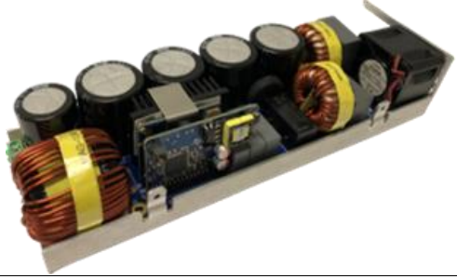
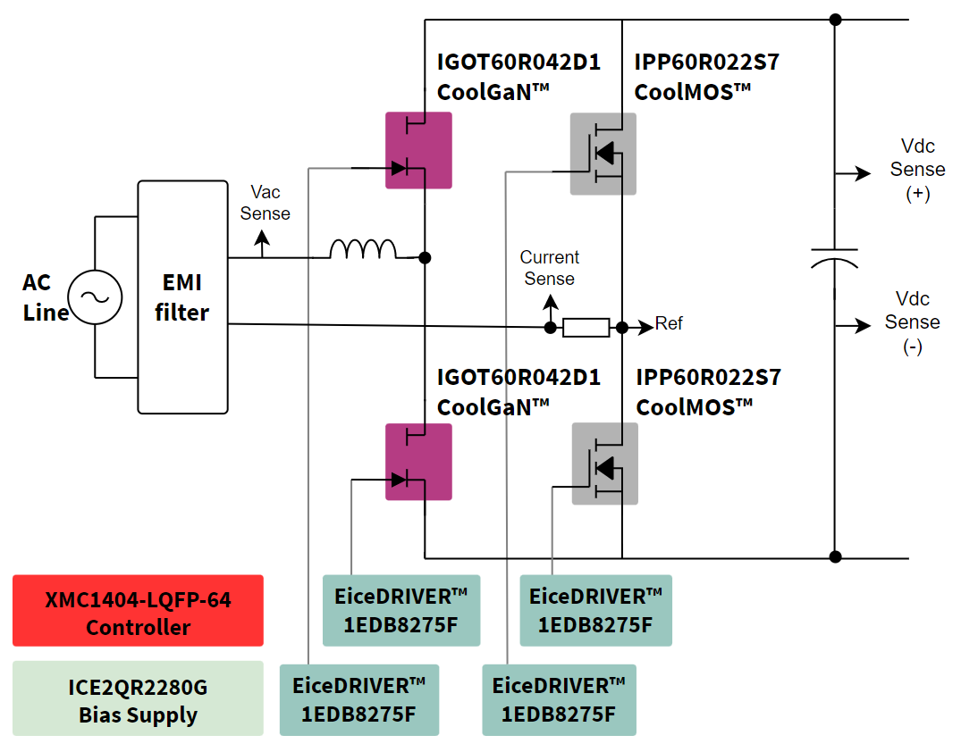
3.4 kW CCM totem-pole PFC evaluation board
CoolGaN™ Transistor 650 V G5 offers better application performance than previous CoolGaN™ generations
Efficiency comparison at highline
DUT
adapter board
CoolGaN™ Transistor 650 V G5 performance is better than previous CoolGaN™ generations
CoolGaN™ Transistor 650 V G5 drop-in replacement for previous CoolGaN™ generations and plug & play conversion of existing designs
CoolGaN™ Transistor 650 V G5 offers better performance over competition

Slide 28
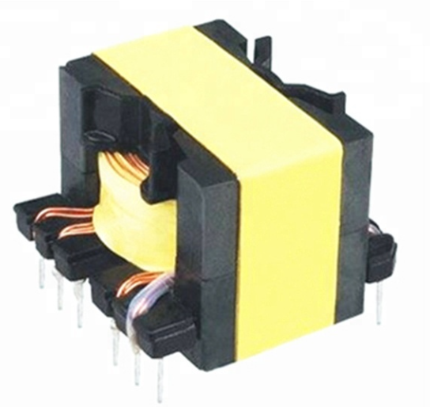
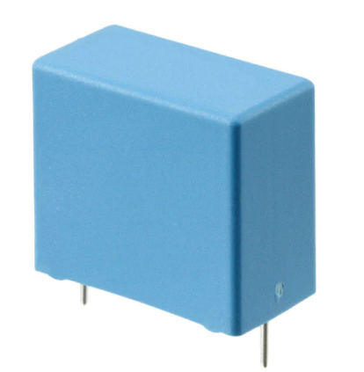
3.2 kW server application, LLC application analysis
CoolGaN™ 650 V G5 enables highest efficiency at increased switching frequencies
Primary-side transistors
Items | V_{DS_max} (V) | I_{D_cont} (A) | R_{DS(on)_typ} (mΩ) 25°C | Total Q_{g} (nC) | Total Q_{rr} (nC)
CoolGaN™ | 650 | 39 | 50 | 6.7 | 0
SiC | 650 | 36 | 60 | 46 | 142
Si MOSFET | 650 | 45 | 50 | 102 | 1200
Size reduction
Component count reduction
× 5
250 kHz
Optimized!
× 2
CoolGaN™ allows increased switching frequency keeping the same power loss
At 250 kHz and above CoolGaN™ offers similar efficiency as at 100 kHz operation
Further increase of power density due to 36 % reduction of resonant tank

Slide 29
Agenda
1
SMPS application description and trends
  4
2
CoolGaN™ in current & next-generation SMPS applications
  8
3
System application boards
  14
4
System-level key takeaways
  18
5
High voltage CoolGaN™ (650 - 700 V)
20
5.1
Technology overview & power device comparison
21
5.2
Value proposition of HV GaN in SMPS
26
5.3
Portfolio leadership
29
6
Medium voltage CoolGaN™ (60 - 200 V)
  31
6.1
Technology overview & power device comparison
32
6.2
Value proposition of MV GaN in SMPS
35
6.3
Portfolio leadership
42

Slide 30




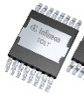
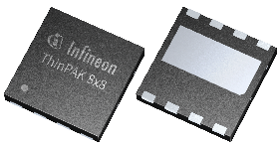
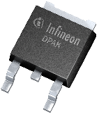
CoolGaN™ Transistor 650 V G5 portfolio
- broad portfolio enabling optimized product selection
 | CoolGaN™ Transistors 650 V G5
R_{DS(on, typ)} _{[mΩ]} | 650 V |  |  |  |  |  | 700 V
 | ThinPAK 5x6 | DFN 8x8 | DSO TSC | TOLL | TOLT | ThinPAK 8x8 | DPAK | ThinPAK 5x6
500 |  |  |  |  |  |  | IGD70R500D2S
270 | IGLR65R270D2 |  |  |  |  |  | IGD70R270D2S | IGLR70R270D2S
200 | IGLR65R200D2 |  |  |  |  |  | IGD70R200D2S | IGLR70R200D2S
140 | IGLR65R140D2 | IGLD65R140D2 |  | IGT65R140D2 |  | IGL65R140D2 | IGD70R140D2S | IGLR70R140D2S
110 |  | IGLD65R110D2 |  |  | IGLT65R110D2 | IGL65R110D2
80 |  | IGLD65R080D2 |  |  |  | IGL65R080D2
55 |  | IGLD65R055D2 | IGOT65R055D2 | IGT65R055D2 | IGLT65R055D2 | IGL65R055D2
45 |  |  | IGOT65R045D2 | IGT65R045D2 | IGLT65R045D2
35 |  |  | IGOT65R035D2 | IGT65R035D2 | IGLT65R035D2
25 |  |  | IGOT65R025D2 | IGT65R025D2 | IGLT65R025D2
17 |  |  |  | IGT65R017D2* | IGLT65R017D2*
ES timeline | Released |  |  | Q3 CY25 | Q3 CY25 | Available | Available | Available
QS timeline |  |  |  | Q1 CY26 | Q1 CY26 | Q3 CY25 | Q3 CY25 | Available
SOP |  |  |  | Q2 CY26 | Q2 CY26 | Q3 CY25 | Q3 CY25 | Q1CY25
Medium Power SMPS
High Power SMPS
Released
Coming soon
*timeline to be done

Slide 31
Agenda
1
SMPS application description and trends
  4
2
CoolGaN™ in current & next-generation SMPS applications
  8
3
System application boards
  14
4
System-level key takeaways
  18
5
High voltage CoolGaN™ (650 - 700 V)
  20
5.1
Technology overview & power device comparison
21
5.2
Value proposition of HV GaN in SMPS
26
5.3
Portfolio leadership
29
6
Medium voltage CoolGaN™ (60 - 200 V)
31
6.1
Technology overview & power device comparison
32
6.2
Value proposition of MV GaN in SMPS
35
6.3
Portfolio leadership
42
Notes:
Slide for Moderator

Slide 32
Agenda
1
SMPS application description and trends
  4
2
CoolGaN™ in current & next-generation SMPS applications
  8
3
System application boards
  14
4
System-level key takeaways
  18
5
High voltage CoolGaN™ (650 - 700 V)
  20
5.1
Technology overview & power device comparison
21
5.2
Value proposition of HV GaN in SMPS
26
5.3
Portfolio leadership
29
6
Medium voltage CoolGaN™ (60 - 200 V)
31
6.1
Technology overview & power device comparison
32
6.2
Value proposition of MV GaN in SMPS
35
6.3
Portfolio leadership
42

Slide 33
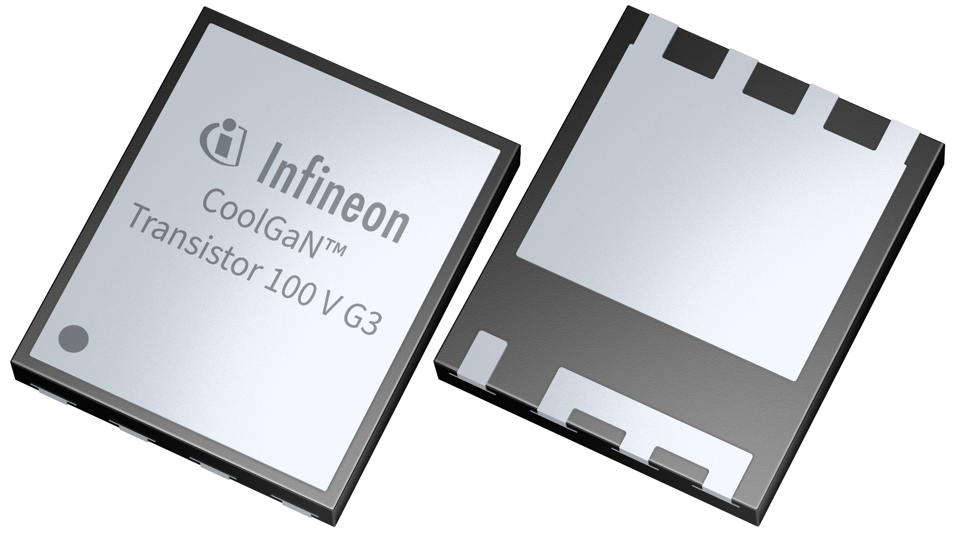
CoolGaN™ Transistor 100 V G3 & Si: FOM comparison
 | CoolGaN™ Transistor 100 V G3 | 100 V BiC Si
Package | RQFN 5x6, DSC | SuperSO8, BSC
R_{DS(ON),max} | 1.4 mΩ | 2.24 mΩ
R_{DS(ON),typ} | 1.1 mΩ | 1.8 mΩ
Q_{oss,typ} | 94 nC | 135 nC
Q_{rr,typ} | 0 nC | 70 nC
Q_{g,typ} | 24 nC | 73 nC
CoolGaN™ Transistors Medium Voltage RQFN products set a new benchmark in power systems design
They offer a first for GaN routable QFN (RQFN) package form factor
Enables seamless integration into existing solutions
Reducing the need for substantial layout changes or the creation of new board designs
CoolGaNTM offers 60% lower R_{DS(ON)}, 40% lower Q_{oss}, 3x lower gate losses and Zero Q_{rr}

Slide 34
Efficiency over I_{OUT} at different switching frequencies
V_{IN} = 48V, V_{OUT} = 12V
With GaN
f_{SW}=1 MHz
Smaller inductor!
With Si:
f_{SW}=200 kHz
Big inductor!
CoolGaN™
Switching at higher frequencies allows the use of smaller and lower cost passive components for DC/DC applications
Si FETs get too hot at higher frequencies, while GaN run much cooler, and provide high efficiencies!
Si FETs
CoolGaN™
Si FETs get too hot even at 10 A!!
Si FETs
CoolGaNTM offers substantial advantages at higher frequencies 1 MHz compared to Silicon FETs

Slide 35
Agenda
1
SMPS application description and trends
  4
2
CoolGaN™ in current & next-generation SMPS applications
  8
3
System application boards
  14
4
System-level key takeaways
  18
5
High voltage CoolGaN™ (650 - 700 V)
  20
5.1
Technology overview & power device comparison
21
5.2
Value proposition of HV GaN in SMPS
26
5.3
Portfolio leadership
29
6
Medium voltage CoolGaN™ (60 - 200 V)
31
6.1
Technology overview & power device comparison
32
6.2
Value proposition of MV GaN in SMPS
35
6.3
Portfolio leadership
42

Slide 36
LLC – ZVS (zero voltage switching) & parasitics
Equivalent switch node capacitance Csw:
  Primary Coss
  SR Coss
  SR reverse recovery charge (Si)
  Transformer parasitic capacitance
  Layout stray capacitance
  ZVS could only be ensured if L_{m} energy overcome Csw energy
SR switch capacitance is essential for primary zero voltage switching mechanism

Slide 37
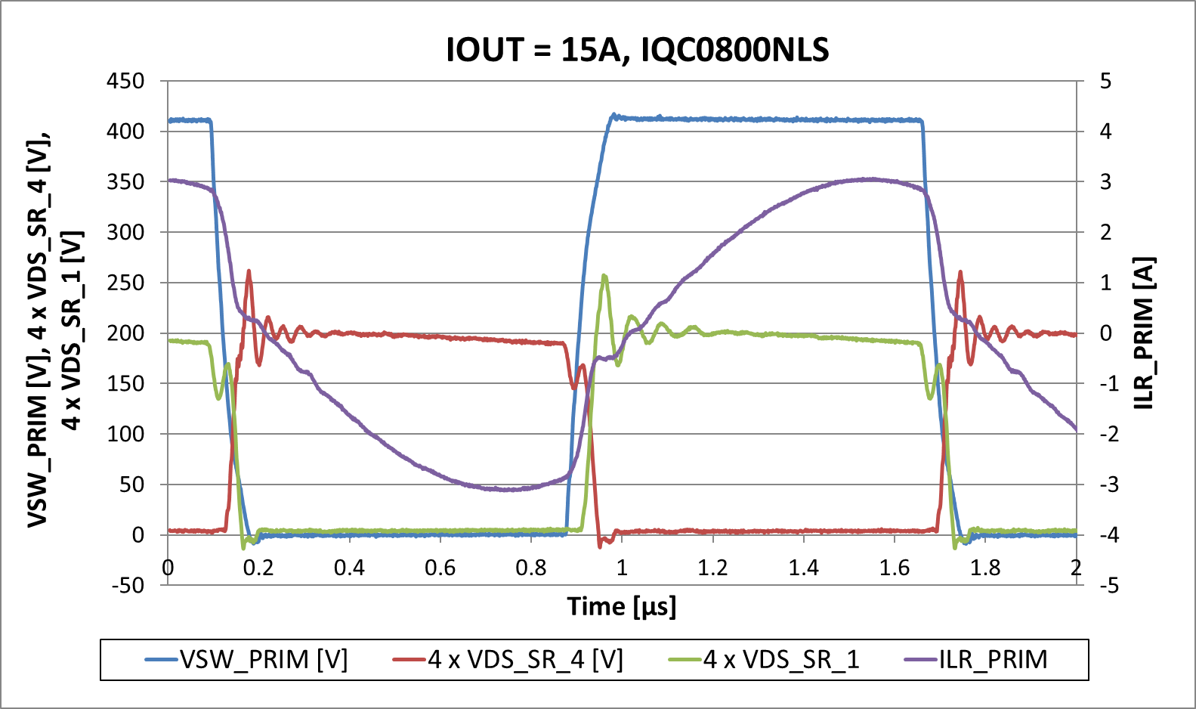
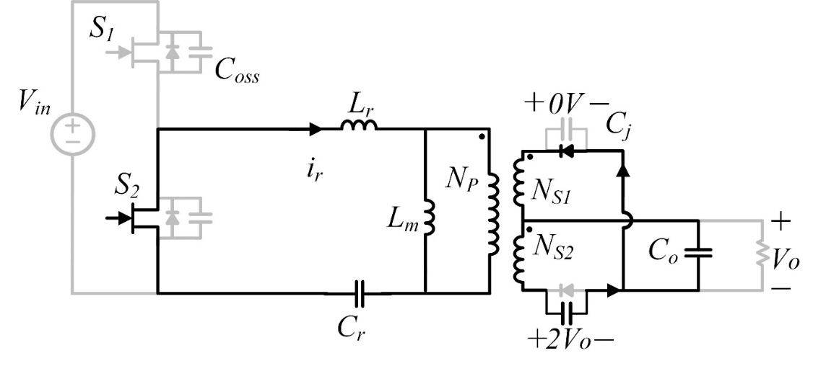
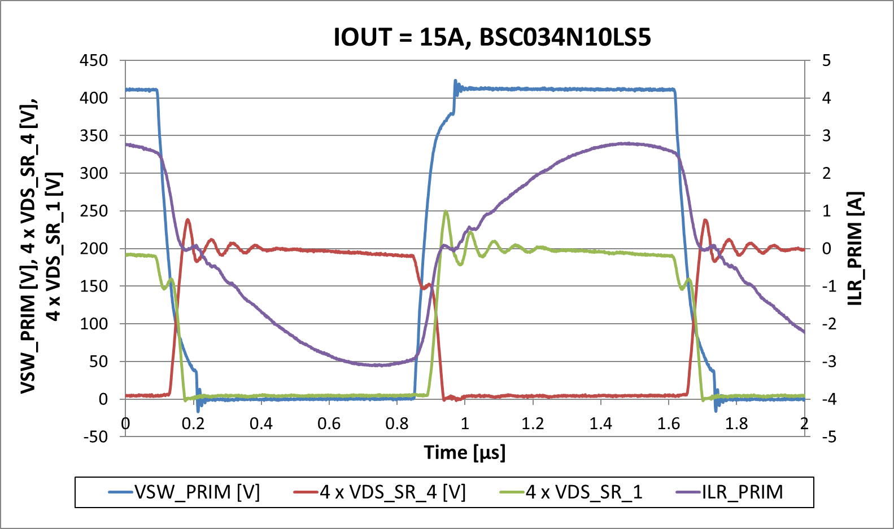
ZVS energy – GaN vs Si SR
IGC033S101
GaN SR
Si SR
GaN SR enables easier primary zero voltage switching than Si SR

Slide 38
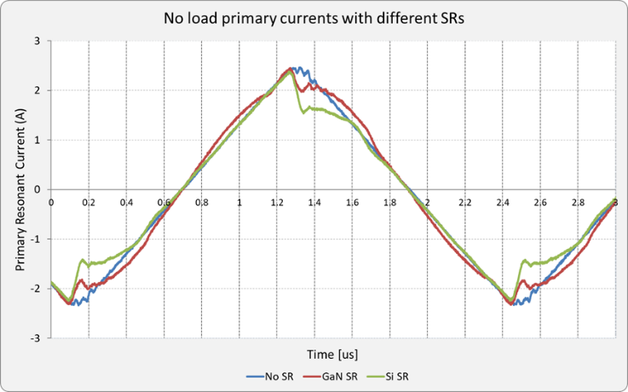
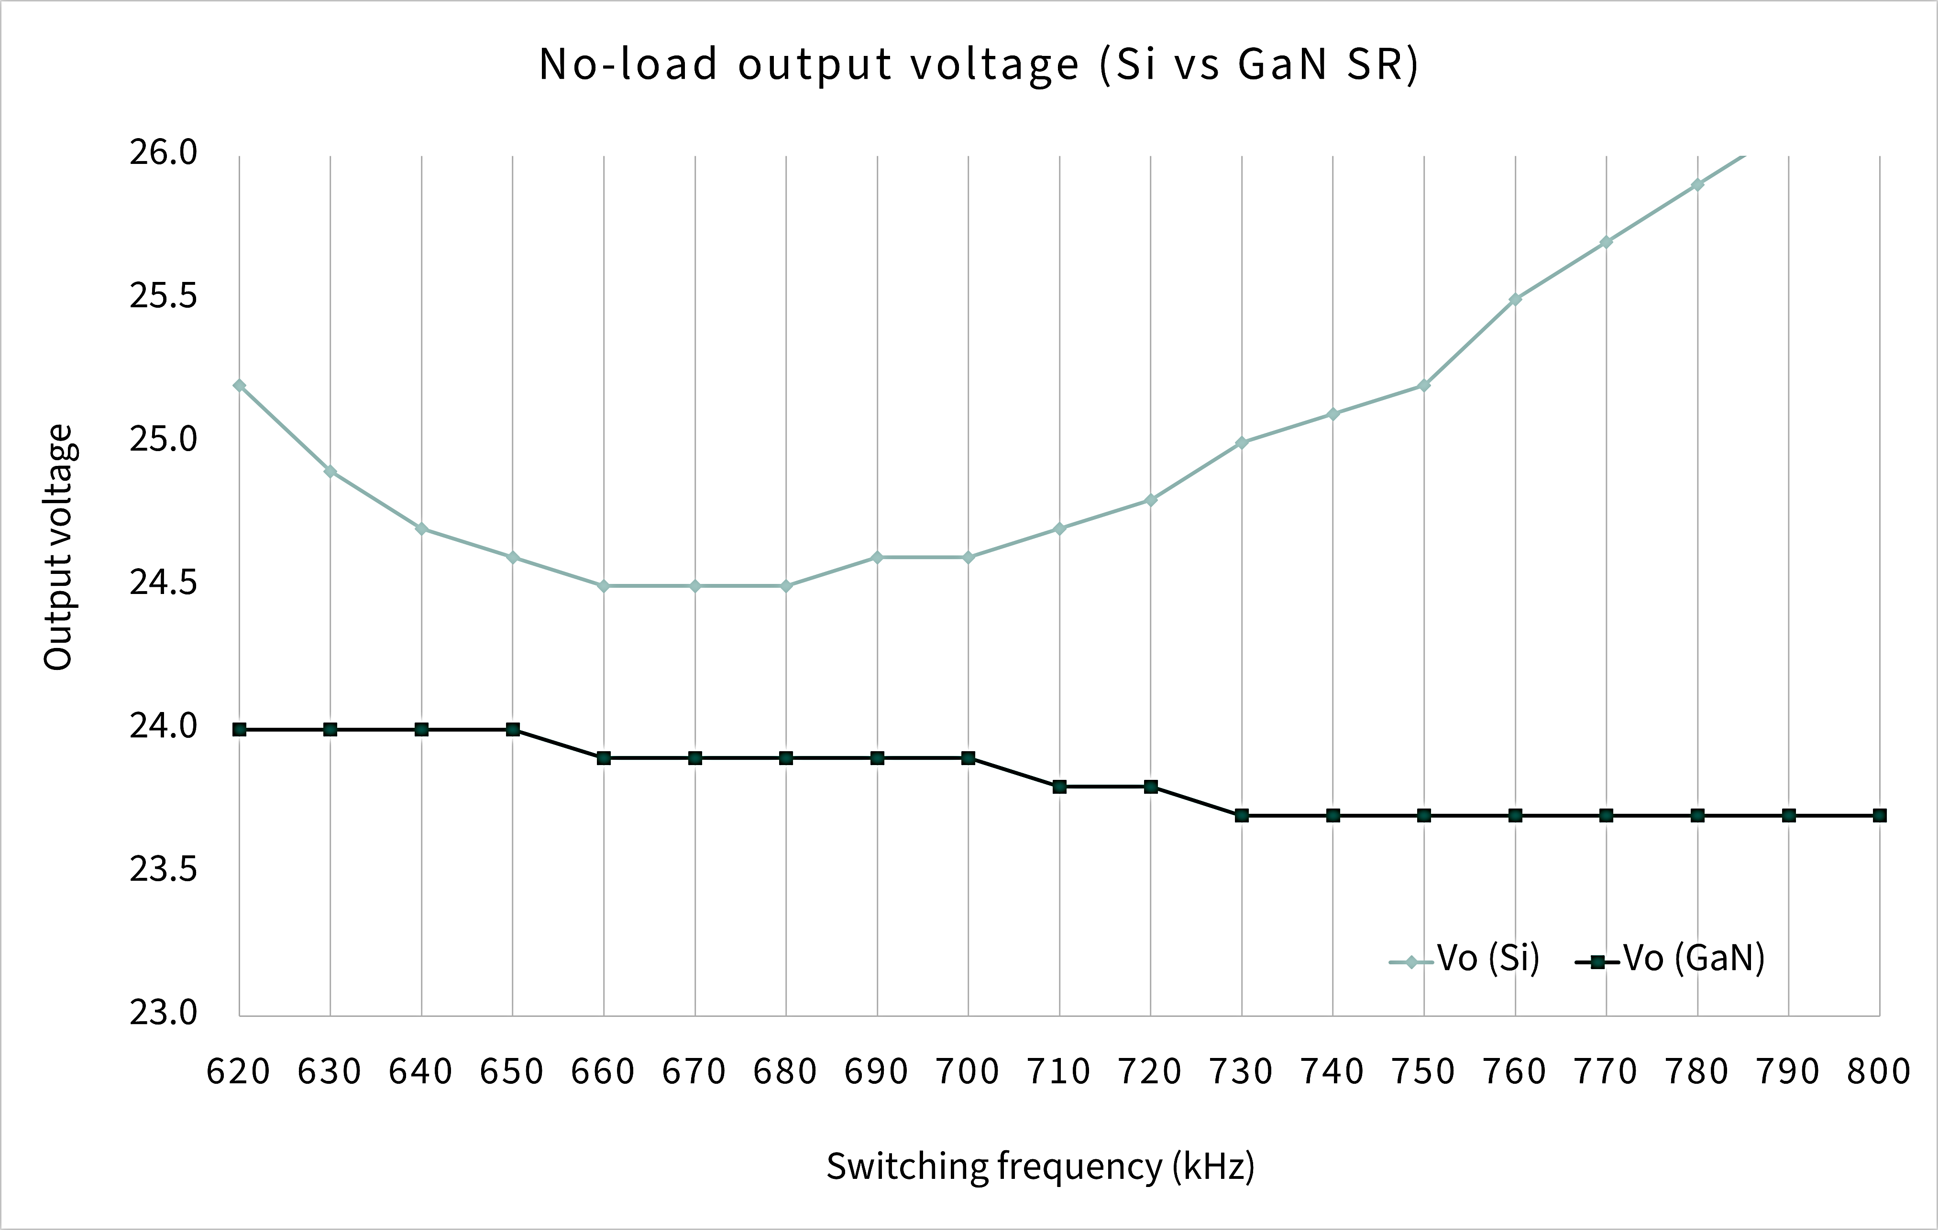
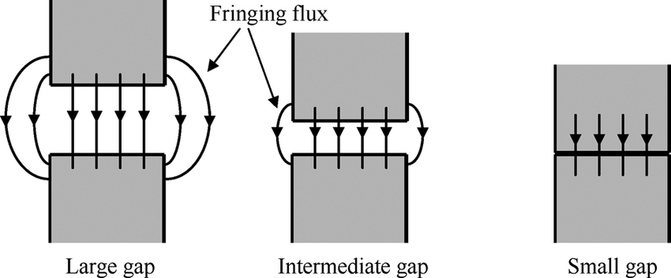
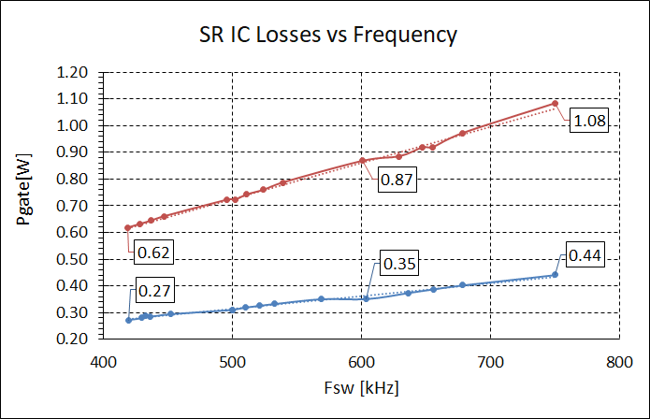
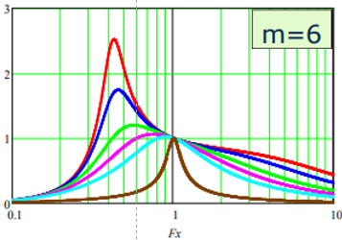
CoolGaN™ SR in LLC
GaN
Less RMS losses
(Q_{oss}) Lower device charge ->
  Lower circulating current
  Less fringing flux due to lower T_{x} air gap
  Less dead-time needed
  Better control at no load
(Q_{g}) Lower gate charge -> Lower gate-drive losses
(R_{DS(on)}) Lower resistance per area -> Smaller package
(Q_{rr}) Lack of reverse recovery– Allows above resonance
Less dummy load
Reduced AC losses
Wider control range
Reduced gate losses

Slide 39
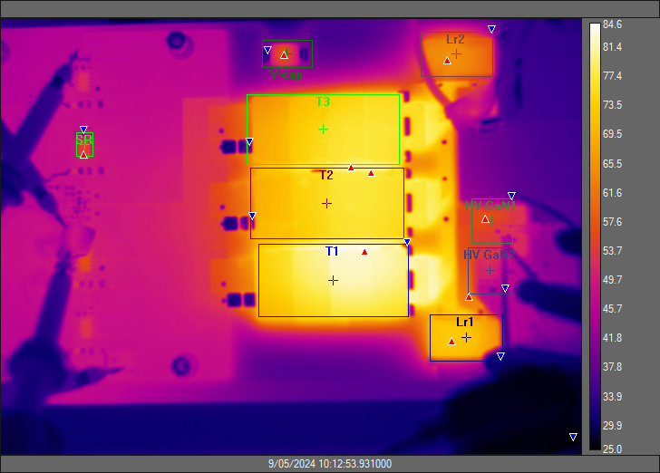
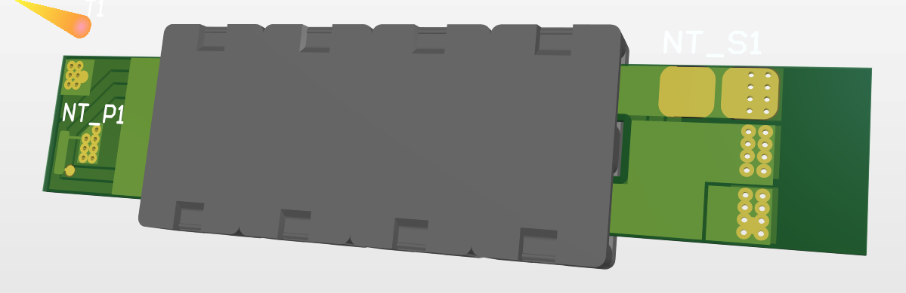
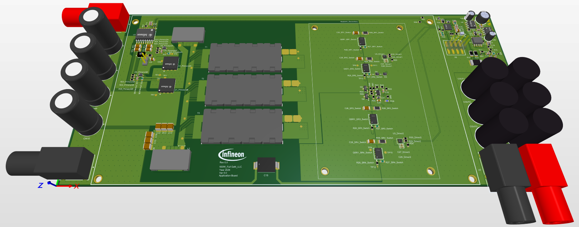
6.5 mm TV SMPS evaluation board with CoolGaN™
Parameters | Values | Parameters | Values
V_{in} | 365 ‑ 405 V_{DC} | L_{r} | 6 µH
V_{out} | 22 V_{DC} | C_{r} | 4 x 4.7 nH
F_{res} | 500 kHz | L_{m} | 40 µH
N | 9:1:1 | Height | <6.5 mm
GaN SR is a high frequency SMPS enabler due to its superior properties

Slide 40
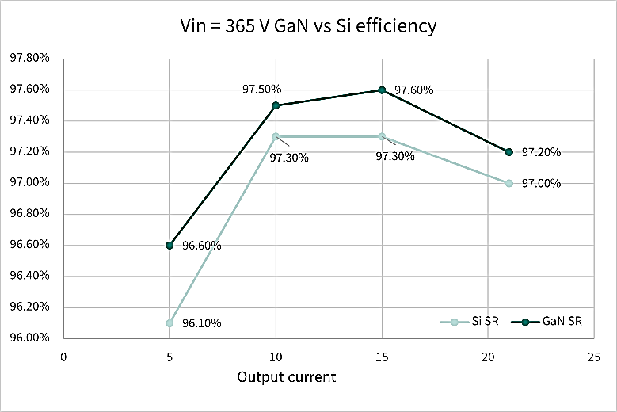
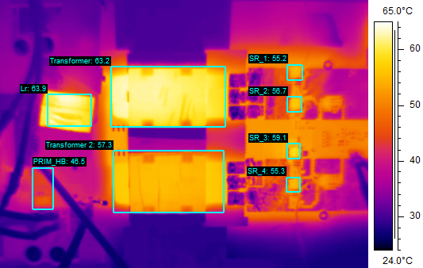
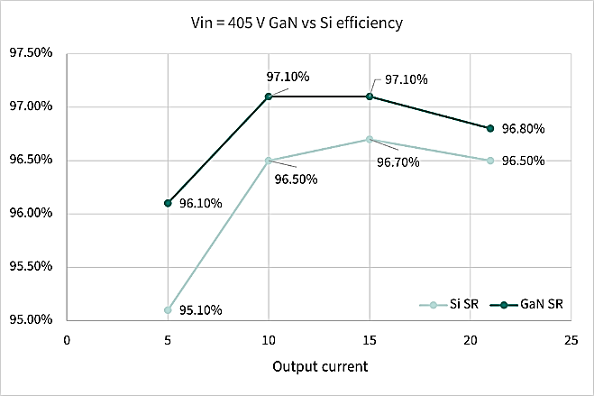
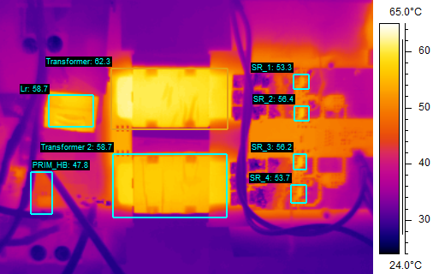
Results - GaN vs Si SR
Up to 0.3%
Below resonance
Si SR
Up to 0.6%
Q_{rr} impact is here
GaN SR
Above resonance
GaN SR perform better up to 0.3% below resonance and 0.6% above resonance than Si SR

Slide 41
CoolGaN™ Transistors 100 V G3 value proposition in SMPS
GaN used as synchronous rectifier (SR) in LLC converter:
Reduced Rdson/Area -> Conduction losses improved
Reduced primary RMS current -> Lower ZVS energy
Reduced dead-time -> Faster switching times
Reduced fringing flux -> Lm can be increased
Reduced gate loss -> Lower gate charge -> Easy paralleling
Improves the converter efficiency
Facilitates voltage regulation at no load
Less dummy load -> Reduced stand-by losses
Enables above-resonance due to the absence of Q_{rr}
Wider control frequency range -> LLC above resonance

Slide 42
Agenda
1
SMPS application description and trends
  4
2
CoolGaN™ in current & next-generation SMPS applications
  8
3
System application boards
  14
4
System-level key takeaways
  18
5
High voltage CoolGaN™ (650 - 700 V)
  20
5.1
Technology overview & power device comparison
21
5.2
Value proposition of HV GaN in SMPS
26
5.3
Portfolio leadership
29
6
Medium voltage CoolGaN™ (60 - 200 V)
31
6.1
Technology overview & power device comparison
32
6.2
Value proposition of MV GaN in SMPS
35
6.3
Portfolio leadership
42

Slide 43
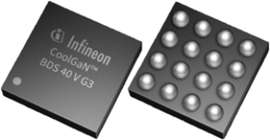




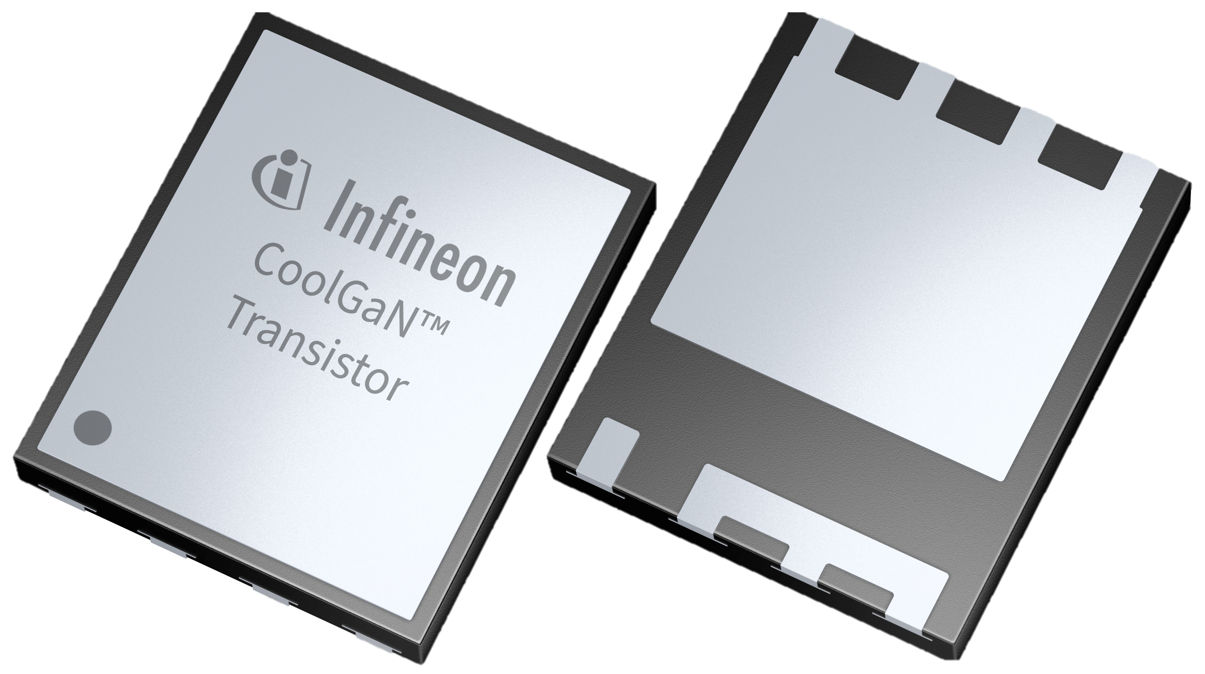
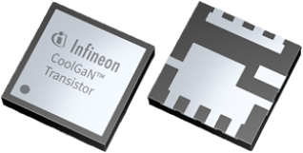
CoolGaNTM 40 – 200 V G3 wide range of transistors and bidirectional switches portfolio
 |  | BDS | CoolGaN™ Transistors G3 |  |  | GaN transistors
Voltage | R_{DS(on)} (Typ @ 25C) | WLCSP | PQFN 3x3 BSC | PQFN 3x3 DSC | PQFN 3x5 BSC | PQFN 3x5 DSC | RQFN 5x6 DD | RQFN 3.3x3.3 SD
200V | 6.7 _{mΩ} |  |  |  |  | * IGC090S20S1¹
120V | 2.7 _{mΩ} |  |  |  |  | IGC037S12S1*
100V | 16 _{mΩ}
 | 9.4 _{mΩ} |  | IGB110S101 | IGB110S10S1
 | 5 _{mΩ} |  |  | IGB070S10S1 *
 | 2.5 _{mΩ} x2
 | 2.4 _{mΩ} |  |  |  | IGC033S101 | IGC033S10S1
 | 1.1 _{mΩ} |  |  |  |  |  | IGD015S10S1
80V | 2.3 _{mΩ} |  |  |  |  |  |  | IGE033S08S1
 | 1.8 _{mΩ} |  |  |  |  | IGC025S08S1
60V | 1.3 _{mΩ} |  |  |  |  | IGC019S06S1
40V | 9 _{mΩ} | IGK012B041S²
 | 6 _{mΩ} | IGK080B041S
 | 4 _{mΩ} | IGK048B041S
Please find below our preliminary timeline, for specific project: all dates are subject to change.
EES |  |  |  |  |  |  | Q1 CY25 | Q1 CY25
ES |  | available | available | available | available | Available
QS |  | Q2 CY25 | productive | productive | productive | Q1 CY25 | Q3 CY25 | Q3 CY25
² SOP: Q1 CY25
¹QS Q1 CY25
Released
In development

Slide 44





CoolGaN™ Transistors 60 - 200 V G3 in 3x5, 3x3 PQFN
ES¹ | Available
SOP² | Q1’25
Final DS available
CoolGaN™ Transistors 60 - 200 V G3
Features
PQFN
Portfolio
Enhancement mode transistor – Normally OFF switch
No reverse-recovery charge
Capable of reverse conduction
Low gate charge, low output charge
Superior commutation ruggedness
Tj = -40°C – 150°C
R_{thJA} 1 layer PCB= 60 °C/W
R_{thJC} Top = 0.5 °C/W
R_{thJC} bottom = 1.9 °C/W
Voltage | R_{DS(on)} typ. | Package | Sales Code
60 V | 1.3mΩ | 3x5 PQFN DSC | IGC019S06S1
80 V | 1.8mΩ | 3x5 PQFN DSC | IGC025S08S1
100 V | 2.4mΩ | 3x5 PQFN BSC | IGC033S101
100 V | 2.4mΩ | 3x5 PQFN DSC | IGC033S10S1
120 V | 2.7mΩ | 3x5 PQFN DSC | IGC037S12S1
100 V | 5mΩ | 3x3 PQFN DSC | IGB070S10S1
200 V | 6.7mΩ | 3x5 PQFN DSC | IGC090S20S1
100 V | 9.4mΩ | 3x3 PQFN BSC | IGB110S101
100 V | 9.4mΩ | 3x3 PQFN DSC | IGB110S10S1
Connected products
Benefits
 | Sales Code | Package
EiceDRIVER™ HB 120V 2EDL50X3U2D* | 2EDL5013U2D | TSNP-12 2x2
EiceDRIVER™ 1EDN71x6x 1CH driver family | 1EDN71x6x | PG-TSNP-7, VSON-10
Digital power controller for 48V DC/DC applications | XDPP11xx | PQFN24, PQFN40
Cost-performance optimized 3x5 PQFN package
Available in BSC and DSC easy to assemble PQFN package
Full system enablement with top cooling
Highest efficiency with low switching losses
Improved power density and overall system cost
*for specific applications
¹Engineering Samples, ²Start of Production

Slide 45
CoolGaN™ Transistors 80 - 100 V G3 in 3.3x3.3 SD, 5x6 RQFN
EES¹ | Q1’25
SOP² | Q3’25
Target DS available
CoolGaN™ Transistors 80 - 100 V G3
Features
RQFN
Portfolio
GaN Transistors 80 – 100 V G3 in Si-footprint packages!
Enhancement mode transistor – normally OFF switch
No reverse-recovery charge
Capable of reverse conduction
Low gate charge, low output charge
Superior commutation ruggedness
Tj = -40°C – 150°C
Voltage | R_{DS(on)} typ. | Package | Sales Code
80 V | 2.3mΩ | 3.3x3.3 RQFN DSC | IGE033S08S1
100 V | 1.1mΩ | 5x6 RQFN DSC | IGD015S10S1
Connected products
Benefits
 | Sales Code | Package
EiceDRIVER™ HB 120V 2EDL50X3U2D* | 2EDL5013U2D | TSNP-12 2x2
EiceDRIVER™ 1EDN71x6x 1CH driver family | 1EDN71x6x | PG-TSNP-7, VSON-10
Digital power controller for 48V DC/DC applications | XDPP11xx | PQFN24, PQFN40
Best thermal solution in small footprint
Available in DSC easy to assemble RQFN package
Full system enablement with top side cooling
Highest efficiency with low switching losses
Improved power density and overall system cost
*for specific applications
¹Early Engineering Samples, ²Start of Production

Slide 46
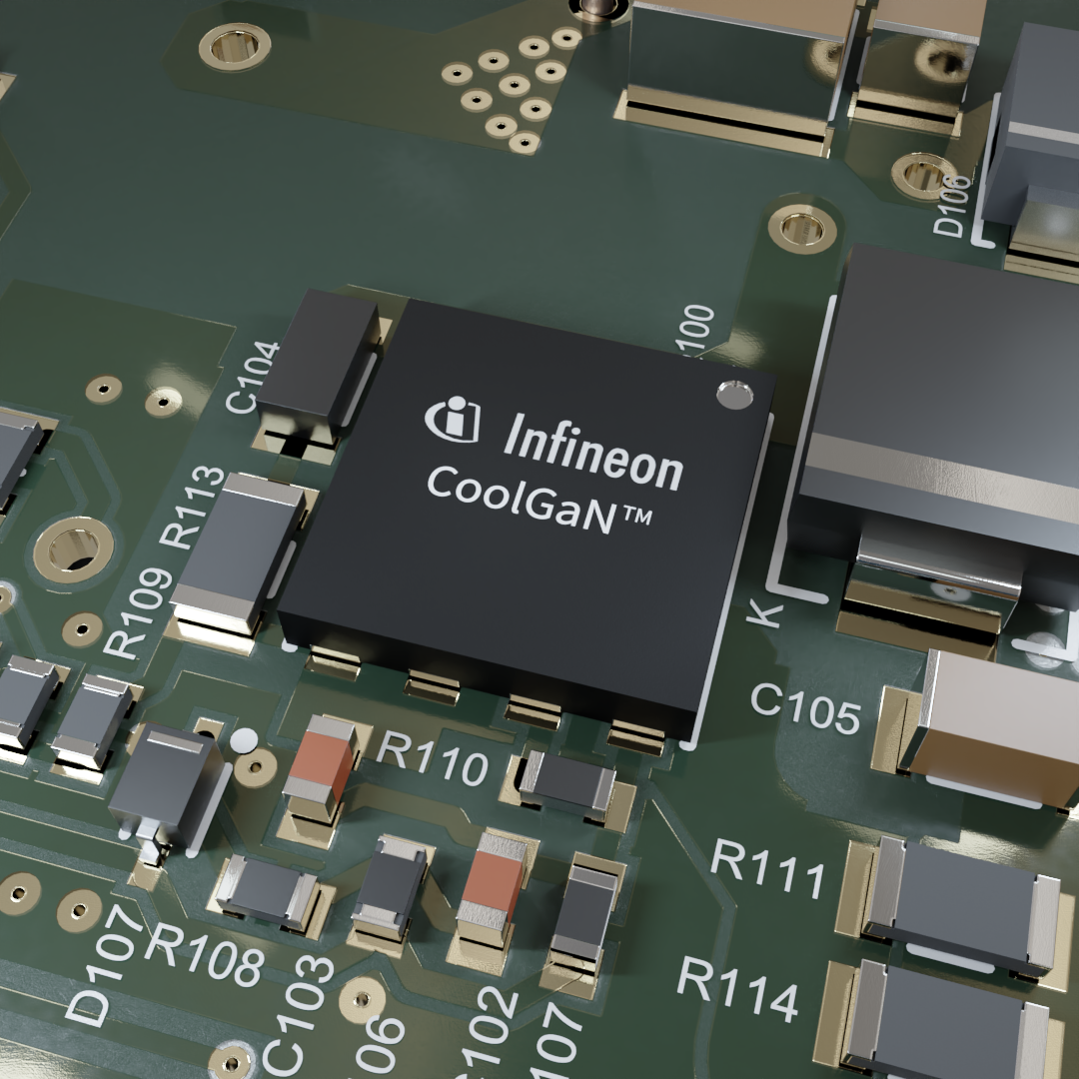
Infineon is your reliable partner with GaN solutions!
Reliability
Density
System solution
Trusted supplier
Notes:
Slide for Moderator

Slide 47
Notes:
Slide for Moderator

